Slide 1
Defining features of linear relationships
Graphical representations of linear equations

Slide 2
how to use Oak lessons

Slide 3
I can appreciate that there are key elements to any linear relationship; rate of change and intercept point.

Slide 4
The rate of change is how quickly one variable changes with respect to another. If the change is constant, there is a linear relationship between the variables.
An intercept is the coordinate where a line or curve meets a given axis.

Slide 5

Defining features of linear relationships
Numerical features of linear relationships
Graphical features of linear relationships

Slide 6
Numerical features of linear relationships
Find the first five terms of the arithmetic (linear) sequence 3n + 2 and describe the sequence in words.
Term number (n) | 1 | 2 | 3 | 4 | 5
Term value (T) | 5 | 8 | 11 | 14 | 17
Term number (n) | 1 | 2 | 3 | 4 | 5
Term value (T)
Term number (n) | 1 | 2 | 3 | 4 | 5
Term value (T)
3n + 2: 5, 8, 11, 14, 17, …
The sequence starts on 5 and has a constant difference of +3 every time.
Those words are unique to this sequence.

Slide 7

Numerical features of linear relationships
Here are the first five terms of the sequence 3n²
Term number (n) | 1 | 2 | 3 | 4 | 5
Term value (T) | 3 | 12 | 27 | 48 | 75
+9
+15
+21
+27
Why is this sequence not linear?
There is not a constant difference.

Slide 8
Numerical features of linear relationships
Complete the table of values for the linear relationship y = 3x + 2
x | 1 | 2 | 3 | 4 | 5
y | 5 | 8 | 11 | 14 | 17
x | 1 | 2 | 3 | 4 | 5
y

Slide 9
Numerical features of linear relationships
The linear relationship y = 3x + 2
The arithmetic
(linear) sequence 3n + 2
Term number (n) | 1 | 2 | 3 | 4 | 5
Term value (T)
Term number (n) | 1 | 2 | 3 | 4 | 5
Term value (T)
x | 1 | 2 | 3 | 4 | 5
y | 5 | 8 | 11 | 14 | 17
Term number (n) | 1 | 2 | 3 | 4 | 5
Term value (T) | 5 | 8 | 11 | 14 | 17
What similarities do you see?
5, 8, 11, 14, 17, …
A constant difference of +3
When plotted, the coordinates (1, 5), (2, 8), (3, 11)...

Slide 10
Numerical features of linear relationships
The linear relationship y = 3x + 2
The arithmetic
(linear) sequence 3n + 2
+1
+1
+1
+1
+1
+1
+1
+1
Term number (n) | 1 | 2 | 3 | 4 | 5
Term value (T)
Term number (n) | 1 | 2 | 3 | 4 | 5
Term value (T)
x | 1 | 2 | 3 | 4 | 5
y | 5 | 8 | 11 | 14 | 17
Term number (n) | 1 | 2 | 3 | 4 | 5
Term value (T) | 5 | 8 | 11 | 14 | 17
+3
+3
+3
+3
+3
+3
+3
+3
We also call this a constant rate of change.
For every change of +1 in x there is a change of +3 in y
For every change of +1 in n there is a change of +3 in T

Slide 11
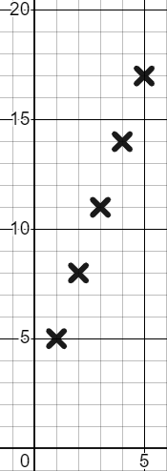
Numerical features of linear relationships
When plotted we can see this rate of change.
3n + 2
+1
+1
+1
+1
T
Term number (n) | 1 | 2 | 3 | 4 | 5
Term value (T)
Term number (n) | 1 | 2 | 3 | 4 | 5
Term value (T)
Term number (n) | 1 | 2 | 3 | 4 | 5
Term value (T) | 5 | 8 | 11 | 14 | 17
+3
+3
+3
+3
For every change of +1 in n there is a change of +3 in T
+3
+1
n

Slide 12
Numerical features of linear relationships
When plotted we can see this rate of change.
y = 3x + 2
+1
+1
+1
+1
y
x | 1 | 2 | 3 | 4 | 5
y | 5 | 8 | 11 | 14 | 17
+3
+3
+3
+3
For every change of +1 in x there is a change of +3 in y
+3
+1
The difference is that x can be any integer or non-integer value.
x

Slide 13
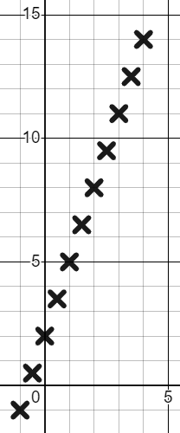
Numerical features of linear relationships
Complete the table of values for the linear relationship y = 3x + 2
x | −1 | −0.5 | 0 | 0.5 | 1 | 1.5 | 2 | 2.5 | 3 | 3.5 | 4
y | −1 | 0.5 | 2 | 3.5 | 5 | 6.5 | 8 | 9.5 | 11 | 12.5 | 14
x | −1 | −0.5 | 0 | 0.5 | 1 | 1.5 | 2 | 2.5 | 3 | 3.5 | 4
y |  |  |  |  | 5 |  | 8 |  | 11 |  | 14
x | −1 | −0.5 | 0 | 0.5 | 1 | 1.5 | 2 | 2.5 | 3 | 3.5 | 4
y
y
We now have coordinates plotted in three quadrants.
We can see that if we plotted the infinite x inputs we would get a straight line.
Our rate of change has not changed. For every change of +1 in x there is a change of +3 in y
x

Slide 14


Numerical features of linear relationships
Which of these is true for the linear relationship y = 8x − 1?
x | −2 | −1 | 0 | 1 | 2 | 3
y | −17 | −9 | −1 | 7 | 15 | 23
For every change of +1 in x there is a change of +8 in y
+8
+8
+8
+8
+8
For every change of +1 in x there is a change of −1 in y
For every change of +2 in x there is a change of +16 in y

Slide 15
Numerical features of linear relationships
Which of these is true for the linear relationship y = 8x − 1?
x | −2 | −1 | 0 | 1 | 2 | 3
y | −17 | −9 | −1 | 7 | 15 | 23
For every change of +1 in x there is a change of +8 in y
+16
+16
For every change of +1 in x there is a change of −1 in y
For every change of +2 in x there is a change of +16 in y

Slide 16
Numerical features of linear relationships
1) These are tables of values for linear relationships. Fill in the missing values and complete the statements about the rate of change.
a)
x | −2 | −1 | 0 | 1 | 2 | 3 | 4
y |  |  | 2 | 7
For every change of +1 in x there is a change of +5 in y
b)
x | −2 | −1 | 0 | 1 | 2 | 3 | 4
y |  |  | −4 |  | 10
For every change of +1 in x there is a change of +7 in y

Slide 17
Numerical features of linear relationships
1) These are tables of values for linear relationships. Fill in the missing values and complete the statements about the rate of change.
c)
x | −2 | −1 | 0 | 1 | 2 | 3 | 4
y |  |  | 2 |  |  |  | 8
For every change of +1 in x there is a change of +1.5 in y
d)
x | −2 | −1 | 0 | 1 | 2 | 3 | 4
y |  |  | 12 |  |  | −3
For every change of +1 in x there is a change of −5 in y

Slide 18
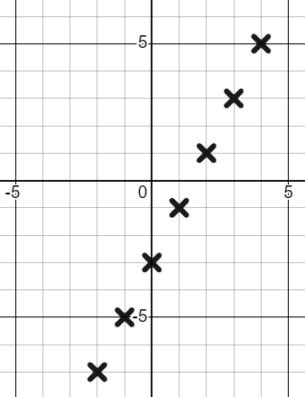
Numerical features of linear relationships
2) Use the graph to complete the table and write a sentence about the rate of change.
y
a)
x | −2 | −1 | 0 | 1 | 2 | 3 | 4
y
x

Slide 19
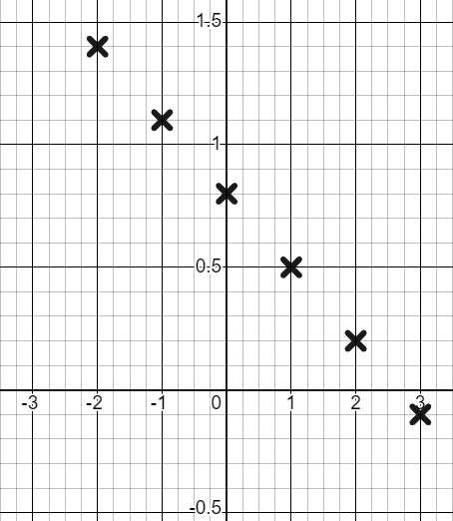
Numerical features of linear relationships
2) Use the graph to complete the table and write a sentence about the rate of change.
y
b)
x | −2 | −1 | 0 | 1 | 2 | 3
y
x

Slide 20
Numerical features of linear relationships
1) These are tables of values for linear relationships. Fill in the missing values and complete the statements about the rate of change.
a)
x | −2 | −1 | 0 | 1 | 2 | 3 | 4
y | −8 | −3 | 2 | 7 | 12 | 17 | 22
x | −2 | −1 | 0 | 1 | 2 | 3 | 4
y |  |  | 2 | 7
For every change of +1 in x there is a change of +5 in y
b)
x | −2 | −1 | 0 | 1 | 2 | 3 | 4
y |  |  | −4 |  | 10
x | −2 | −1 | 0 | 1 | 2 | 3 | 4
y | −18 | −11 | −4 | 3 | 10 | 17 | 24
For every change of +1 in x there is a change of +7 in y

Slide 21
Numerical features of linear relationships
1) These are tables of values for linear relationships. Fill in the missing values and complete the statements about the rate of change.
c)
x | −2 | −1 | 0 | 1 | 2 | 3 | 4
y | −1 | 0.5 | 2 | 3.5 | 5 | 6.5 | 8
x | −2 | −1 | 0 | 1 | 2 | 3 | 4
y |  |  | 2 |  |  |  | 8
x | −2 | −1 | 0 | 1 | 2 | 3 | 4
y |  |  | 2 |  | 5 |  | 8
For every change of +1 in x there is a change of +1.5 in y
d)
x | −2 | −1 | 0 | 1 | 2 | 3 | 4
y |  |  | 12 |  |  | −3
x | −2 | −1 | 0 | 1 | 2 | 3 | 4
y | 22 | 17 | 12 | 7 | 2 | −3 | −8
For every change of +1 in x there is a change of −5 in y

Slide 22
Numerical features of linear relationships
2) Use the graph to complete the table and write a sentence about the rate of change.
y
a)
x | −2 | −1 | 0 | 1 | 2 | 3 | 4
y
x | −2 | −1 | 0 | 1 | 2 | 3 | 4
y | −7 | −5 | −3 | −1 | 1 | 3 | 5
For every change of +1 in x there is a change of +2 in y
x

Slide 23
Numerical features of linear relationships
2) Use the graph to complete the table and write a sentence about the rate of change.
y
b)
x | −2 | −1 | 0 | 1 | 2 | 3
y
x | −2 | −1 | 0 | 1 | 2 | 3
y | 1.4 | 1.1 | 0.8 | 0.5 | 0.2 | −0.1
For every change of +1 in x there is a change of −0.3 in y
x

Slide 24
Defining features of linear relationships
Numerical features of linear relationships
Graphical features of linear relationships

Slide 25
Graphical features of linear relationships
The arithmetic (linear) sequence 2n + 5
Term number (n) | 1 | 2 | 3 | 4 | 5
Term value (T) | 7 | 9 | 11 | 13 | 15
Starts at 7 and changes by +2.
That is unique to this sequence.
What if we said, “Start at 2 and +7 each time”
We would only ever get the sequence 2, 9, 16, 23, 30, … No other sequence could come from this rule.
A given starting point, and a given constant difference, generates a unique arithmetic sequence.

Slide 26
Graphical features of linear relationships
The arithmetic (linear) sequence 2n + 5
Term number (n) | 1 | 2 | 3 | 4 | 5
Term value (T) | 7 | 9 | 11 | 13 | 15
Starts at 7 and changes by +2
The linear relationship y = 2x + 5
x | 1 | 2 | 3 | 4 | 5
y | 7 | 9 | 11 | 13 | 15
Where does this start?
We can’t say, “It starts at 7” because we could have x = 0

Slide 27
Graphical features of linear relationships
The arithmetic (linear) sequence 2n + 5
Term number (n) | 1 | 2 | 3 | 4 | 5
Term value (T) | 7 | 9 | 11 | 13 | 15
The linear relationship y = 2x + 5
x | 0 | 1 | 2 | 3 | 4 | 5
y | 5 | 7 | 9 | 11 | 13 | 15
Where does this start?
We can’t say, “It starts at 5” because we could have x = −1 or x = −2

Slide 28
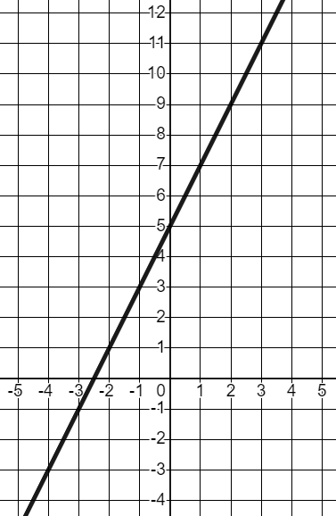
Graphical features of linear relationships
The linear relationship y = 2x + 5
y
x | −2 | −1 | 0 | 1 | 2 | 3 | 4 | 5
y | 1 | 3 | 5 | 7 | 9 | 11 | 13 | 15
When plotted we can see that it has no start and no end. It goes on infinitely in both directions.
However, it has unique features which help us to define it.
x
The y-intercept. Where our line meets the y-axis, in this case at (0, 5).

Slide 29
Graphical features of linear relationships
The linear relationship y = 2x + 5
y
x | −2 | −1 | 0 | 1 | 2 | 3 | 4 | 5
y | 1 | 3 | 5 | 7 | 9 | 11 | 13 | 15
The line y = 2x + 5 intercepts the y-axis at (0, 5) and has a constant rate of change of +2.
x
These features will always produce this straight line.

Slide 30
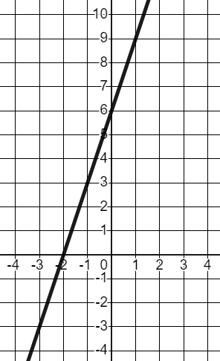
Graphical features of linear relationships
What is the y-intercept of this line?
y
6
(0, 6)
The line intercepts the y-axis at the coordinate (0, 6)
x
(−2, 0)

Slide 31
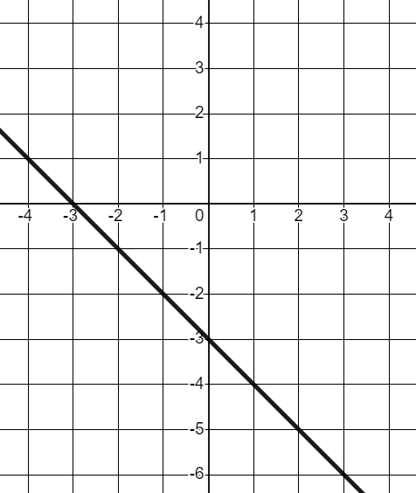
Graphical features of linear relationships
What is the y-intercept of this line?
y
The line intercepts the y-axis at the coordinate (0,−3)
(0, −3)
(0, 3)
x
(−3, 0)

Slide 32
Graphical features of linear relationships
What is the y-intercept of the line plotted from this table of values.?
x | −2 | −1 | 0 | 1 | 2 | 3 | 4 | 5
y | 7 | 6 | 5 | 4 | 3 | 2 | 1 | 0
(5, 0)
(0, −1)
(0, 5)
The line intercepts the y-axis when the x-coordinate is 0.

Slide 33
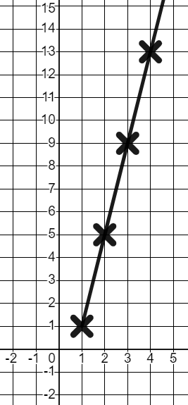
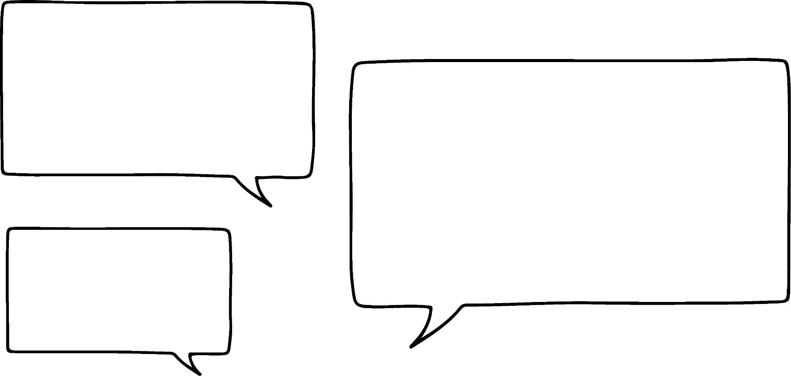

Graphical features of linear relationships
1) Izzy has completed a table of values and plotted coordinates for the linear relationship y = 4x − 3
y
x | 1 | 2 | 3 | 4
y | 1 | 5 | 9 | 13
The line y = 4x − 3 starts at 1 and has a rate of change of +4 each time.
Write a sentence to put in Izzy’s book explaining what she needs to change.
x

Slide 34
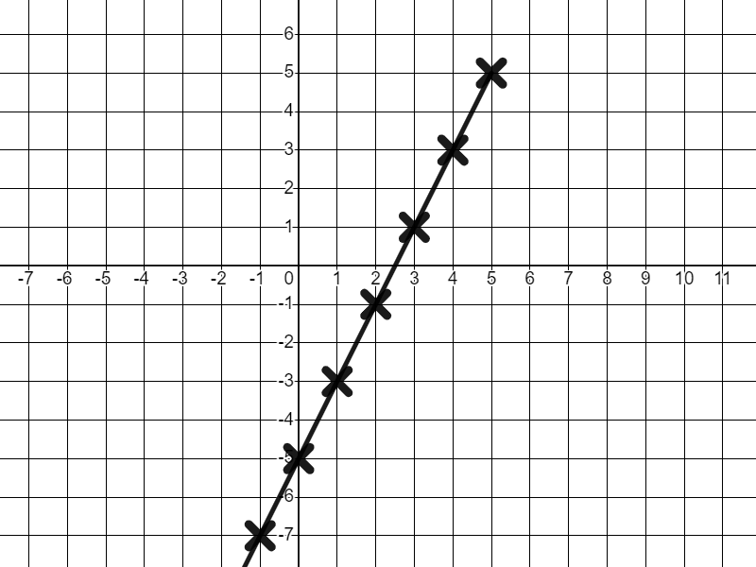
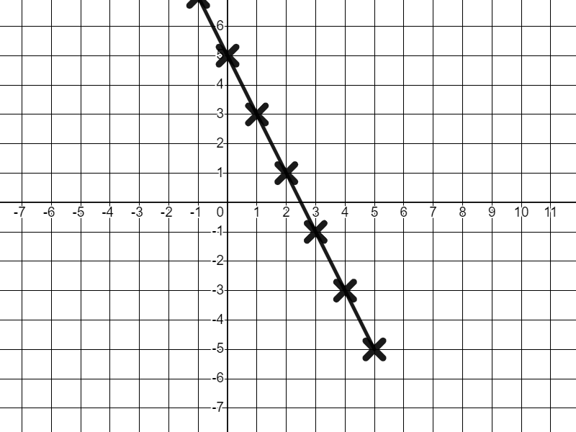
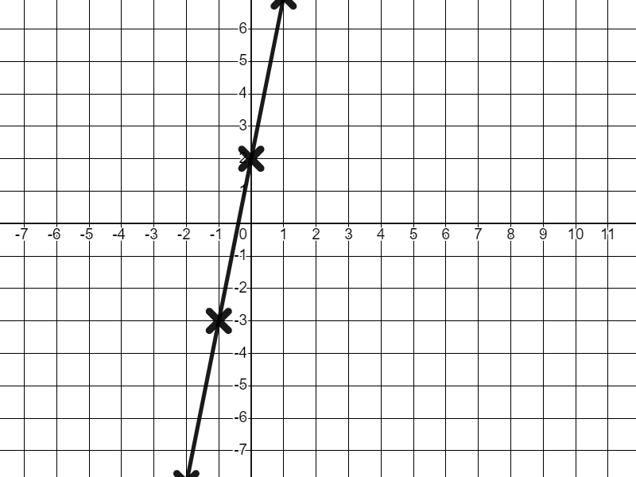
Graphical features of linear relationships
2) Match the graphs to their unique descriptions.
Intercepts the y-axis at (0, 5), rate of change of −2
Intercepts the y-axis at (0, 2), rate of change of +5
Intercepts the y-axis at (0, −5), rate of change of +2

Slide 35
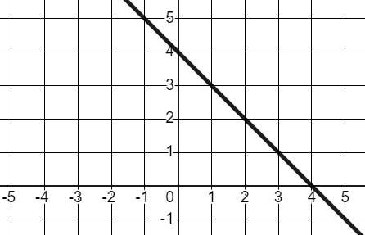
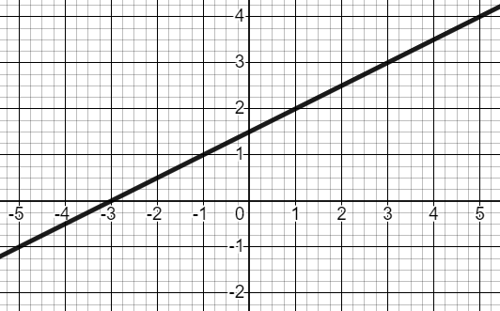
Graphical features of linear relationships
3) Write unique descriptions for these two graphs. Be sure to include the words y-intercept and rate of change.
a)
b)

Slide 36
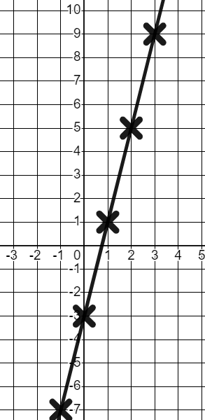
Graphical features of linear relationships
1) Izzy has completed a table of values and plotted coordinates for the linear relationship y = 4x − 3
x | −2 | −1 | 0 | 1 | 2 | 3 | 4
y | −11 | −7 | −3 | 1 | 5 | 9 | 13
y
The line y = 4x − 3 starts at 1 and has a rate of change of +4 each time.
The line y = 4x − 3 has no start or end. You need to continue the line in both directions and plot zero and negative x values.
x

Slide 37
Graphical features of linear relationships
2) Match the graphs to their unique descriptions.
Intercepts the y-axis at (0, −5), rate of change of +2
Intercepts the y-axis at (0, 5), rate of change of −2
Intercepts the y-axis at (0, 2), rate of change of +5

Slide 38
Graphical features of linear relationships
3) Write unique descriptions for these two graphs. Be sure to include the words y-intercept and rate of change.
a)
b)
Intercepts the y-axis at (0, 4), rate of change of −1
Intercepts the y-axis at (0, 1.5), rate of change of +0.5

Slide 39
Defining features of a linear relationship
I can appreciate that there are key elements to any linear relationship; the rate of change and intercept point with the y-axis.
This description is unique to any given linear relationship.

Slide 40

© Oak National Academy 2023.
Produced in partnership with Mathematics in Education and Industry.
Licensed on the Open Government Licence v3.0, except where otherwise stated. See Oak terms and conditions.

